Slide 1


Secure Mobile SDN
Ankur Chowdhary
(achaud16@asu.edu)
(Master’s in Computer Science Defense)
Committee: Dr. Dijiang Huang (Chair)
Dr. Hasan Davulcu
Dr. Hanghang Tong

Slide 2
Index
Problem Statement , Motivation and Goals
Related Work in The Field
System Architecture and Design
Implementation Details
Scope for Future

Slide 3
Problem Description
Users want their devices to perform many tasks such as read email, play games, and run other online applications and organizations no longer desire to provision and maintain individual's IT equipment.
Need for BYOD (Bring Your Own Device) infrastructure?
BYOD - A term coined by Marketer’s to describe consumerisation of IT.
Alignment of Telecos and IT requires a solution that makes the operation of data centers more manageable and traffic routing more flexible.

Slide 4
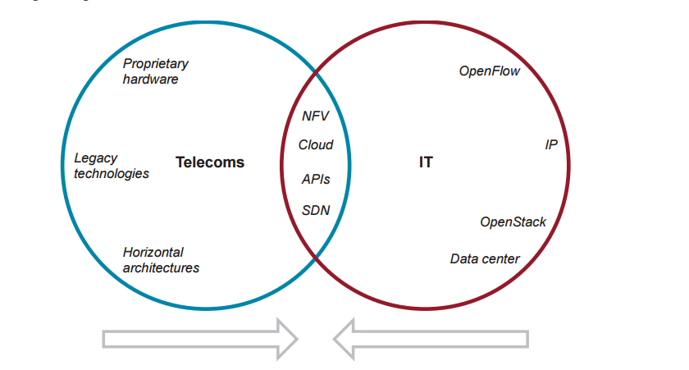
IT – Telecos Convergence Motivation
The telecoms and IT infrastructures are starting to converge, with mobile operators using IT concepts to streamline or improve their infrastructure or using IT architectures for new opportunities, including cloud services.
Need for efficient traffic handling, resource allocation, security compliance, operational efficiency for centralized cloud services.
OpenFlow and Openstack are such concepts.

Slide 5
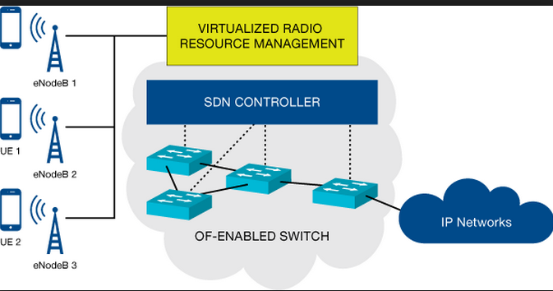
Cloud Edge Controller
Existing SDN framework is suitable for wired network.
We can run an edge cloud controller such as SDN to provide security, QoS to client device.
Need to push SDN to the clients(edge).

Slide 6

Should Employees be allowed to use their Devices for Work?
Pro’s
Shift’s the cost to user. Companies save a lot.
Technology of devices cutting edge , organizations get benefit of latest features.
Cons
Data and ownership compliance issue.
Security issues- minimum security requirements, company sanctioned security tools as condition for allowing personal devices to connect to company data and network resources.

Slide 7

Challenges Faced
Configuring the proper bootloader, and patch to run board in HYP mode.
Faulty Cross Compiler and build sources, because too many distributions are available.
Selecting proper kernel version for Host OS and Guest OS.
Identifying boot sequence and booting kernel from correct address space.
Dependency issues of Open vSwitch on various modules and compatibility of Open vSwitch with correct kernel version.
ARM specific Qemu for device emulation.
Source code or kernel headers for building the kernel.
Booting Guest OS on top of Open vSwitch instead of bridged network.

Slide 8
Secure Mobile SDN to Rescue
Need for an Efficient Solution in Mobile Device Environment.
ARM based Secure Mobile SDN framework will potentially resolve these issues and enable employees/users to consolidate both personal and business calls and mobile data access on a single device.
It will allow the IT industry/ telecos to monitor the security policies, traffic routing decision using centralized SDN Controller that monitors the state of device.

Slide 9
Contribution
Prepare Host kernel and file system for ARM based host platform.
Prepare a guest kernel and file system for booting on top of host OS.
Install and configure Open vSwitch on the top of host OS and create an openflow bridged network connecting guest OS to bridge.
Boot guest OS on top of host OS using Open vSwitch using qemu emulator.
Implement SDN Controller for management and policy enforcement.

Slide 10
Related Work

Slide 11
Technique Used | Features | Advantages | Challenges Faced
End User Virtualization | Multiple systems on same physical machine. App can be running in end user device or data-center. | Security broker mediated authentication. Clean Separation of OS and user profile. | Difficult to capture useful network dynamics. Difficult to observe state of processes inside sandboxed VMs.
Prioritized Defense Deployment | Used distributed algorithm to capture the temporal and spatial characteristics in enterprise environment. | Significant cost gains in terms of threat detection and patching mechanism. | No practical implementations suggesting scalability and robustness.
MOSES | Mode of Separation through controlled software Isolation. Make use of policy enforcement. | Context based security gives a good view of security profile. User requirement based profile. | Limited only to Android platform. It has not been tested on other platforms.
XEN Virtualization | Type-1 hypervisor, runs directly on hardware, everything else runs as VM on top of XEN. Dom0 is privileged VM. | It does not require an emulation environment, and as a result is faster and much more secured. | Virtualization support for mobile platform devices such as GPS, camera for more than one VM, require new paravirtualized font ends and back ends.

Slide 12
System Architecture and Design

Slide 13
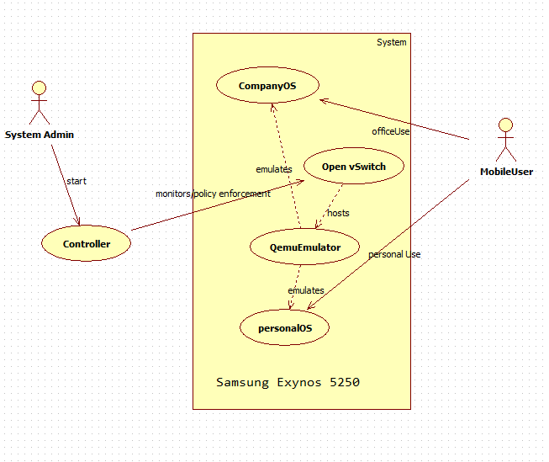
Secure Mobile SDN Use Case

Slide 14
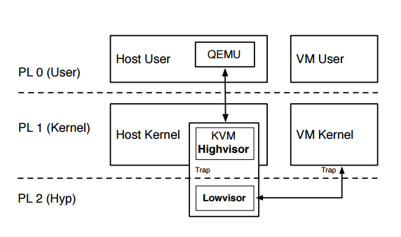
ARM Architecture and KVM

Slide 15
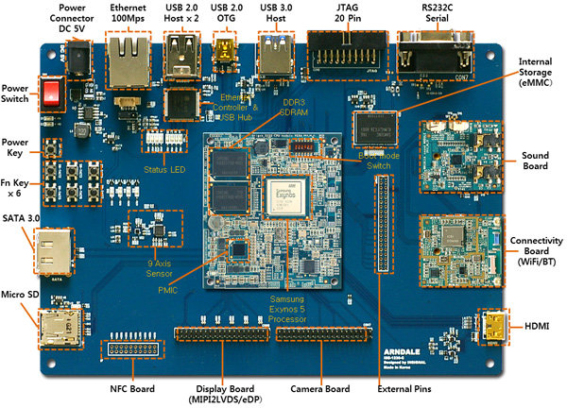
Base Model Samsung Arndale Exynos 5250

Slide 16
Architecture Enhancements
Design of stable host and guest OS.
Implementation of Open vSwitch on top of Arndale.
Design of Qemu-KVM architecture.
Design of a bridged network to boot Guest OS on top of Host Ubuntu based OS.
Implementation of controller on top of Host OS or remote controller to insert flows for management and security.

Slide 17
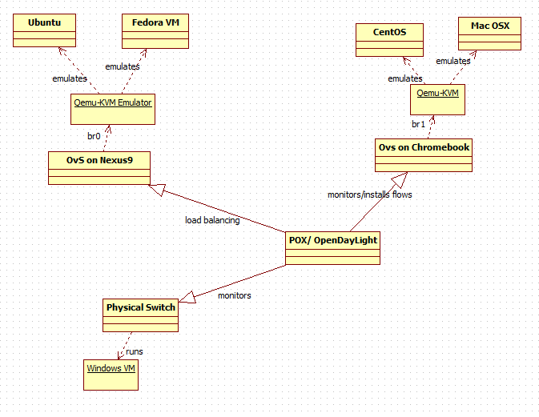
Contributed Architecture

Slide 18
Virtualization Challenge
Kernel must somehow be able to run code in HYP-mode.
Idea to split execution across multiple CPU modes with little code in HYP mode is being used.
Code run in HYP mode is limited to few hundred instructions.
The hypervisor is split into two components to provide this functionality, namely: highvisor and lowvisor.
Lowvisor deals with setting up of execution context, isolation between contexts, context switches between host and guest execution modes.
Highvisor on the other hand deals with scheduling, locking mechanism and memory allocation functions.

Slide 19
KVM
The virtualization method used is KVM (Kernel Based Virtual machine).
Exposes /dev/kvm to user space.
Requires a user space host to run e.g- QEMU.
kvm.ko module provides virtualization interface via /dev/kvm.
Device emulation, along with setup and configuration of VMs, is handled by a user space process, typically QEMU.

Slide 20
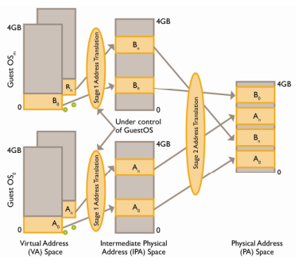
Memory Virtualization
When running VM physical address used are guest physical address and need to be translated to host physical address.
ARM provides Stage-2 page tables having format resembling normal Virtual to Physical page tables.
They are stored in normal memory and used by hardware to translate guest physical address to host physical address.

Slide 21
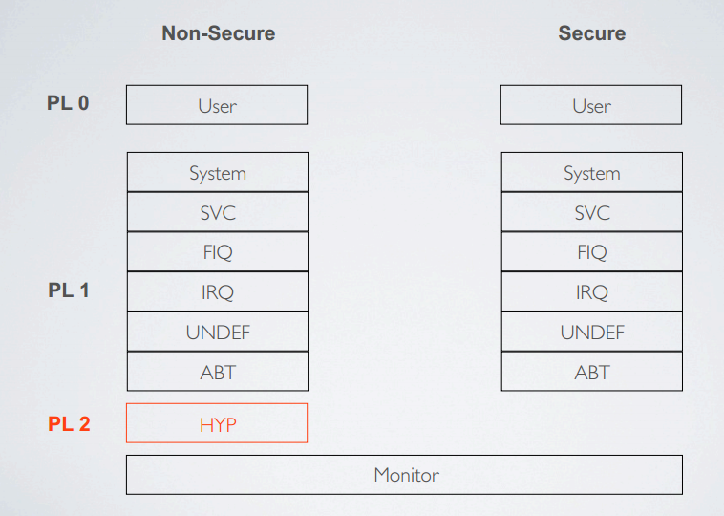
CPU Virtualization
Trust Zone is splitted into Secure and Non-Secure.
The secured mode doesn’t have support for HYP mode.
Allows context switching guest accessible registers.
Traps access to other registers and emulate in software.

Slide 22
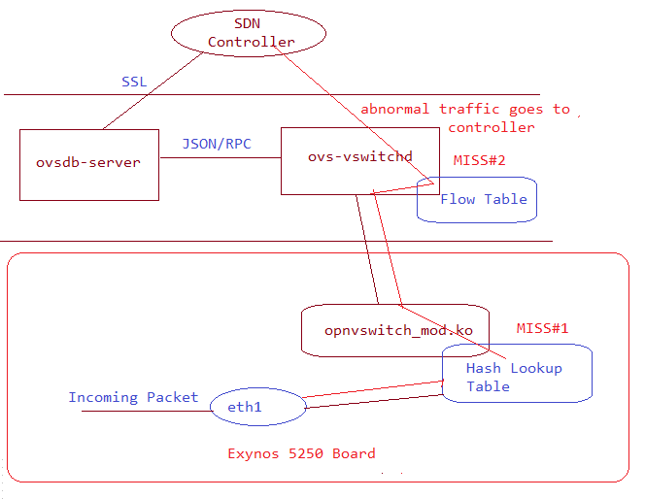
Open vSwitch-SDN Interactions
Normal traffic lookup takes place in hash lookup table.
Incase of flow-miss entry the packet is directed to controller.
Controller will take appropriate action such as blocking/redirecting.

Slide 23
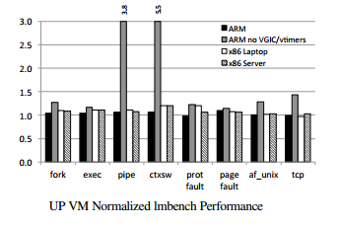
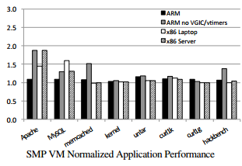
KVM/ARM vs KVM x86 Performance Comparison
ARM and x86 have similar performance overhead in lmbench single core benchmarking.
KVM/ARM using VGIC/vtimers achieves better power efficiency than x86 for all cases except memcached and untar on a multicore architecture.

Slide 24
Implementation Details

Slide 25
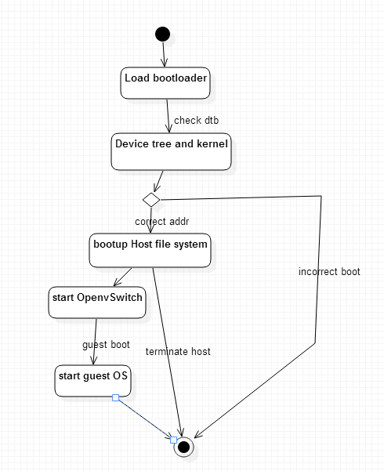
Activity Diagram

Slide 26
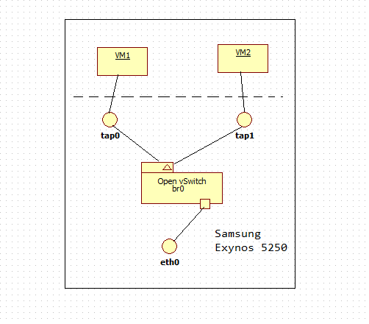
Proposed Solution
Initialize bootloader to run HYP mode.
Boot the Host OS
Install and configure Open vSwitch and its support modules
Boot Guest OS on top of Open vSwitch
Implement controller to install flows.

Slide 27
Novel Aspects/ Applications
OpenFlow switch such as Open vSwitch can have multiple packet handling rule tables.
OpenFlow has the flexibility to behave as Firewall, switch, Network Address Translator (NAT).
The goals we wish to target is enforcement of security policy separately for each part of network , for instance we may want to allow limited access to finance department servers so we can enforce security policy and isolate resources in that particular department by VLAN tagging and specific traffic flow rules for that particular VLAN.
Second advantage is that if we have abnormal traffic behavior within the network/VLAN, the controller can flag the event as Intrusion based on rules specified and quarantine a particular VM.

Slide 28
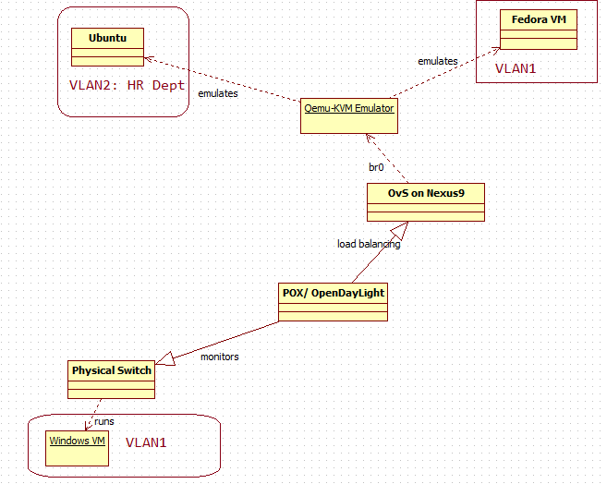
Resource Isolation and Management

Slide 29
Two people from same department one having Mac Air and another having Samsung Galaxy Tab can run company provided guest OS on the fly.
The controller would Group them in same VLAN according to the deviceID tagging, MAC associated with a devices, etc. So policies and access rules for that particular VLAN will apply to these two tablets.
The Guest OS images can be synced with secured datacenter images at a remote location.
The controller would Group them in same VLAN according to the deviceID tagging, MAC associated with a devices, etc. So policies and access rules for that particular VLAN will apply to these two tablets.

Slide 30
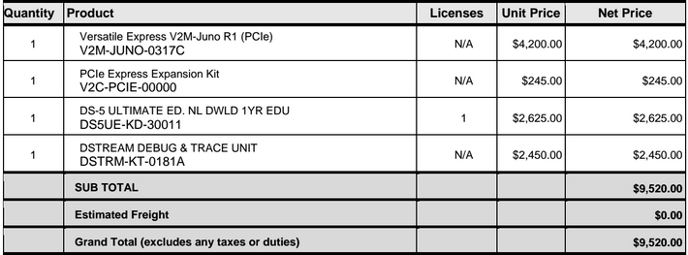

COST EFFECTIVE SOLUTION
While a solution on Arndale development board costs = $150. A cost saving of ~($9350) per development board.

Slide 31
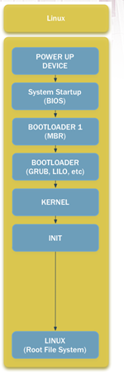
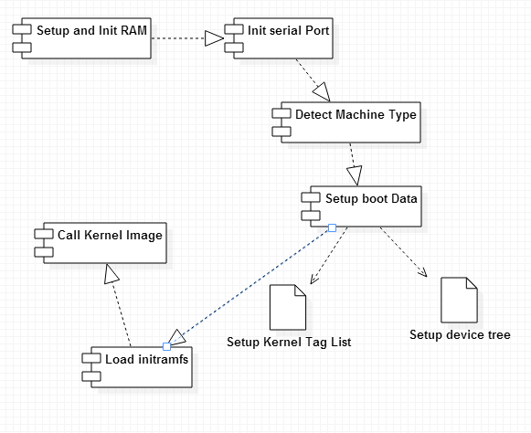
Bootloading in ARM

Slide 32
Fusing the u-boot
$ sudo dd if=arndale-bl1.bin of=/dev/sdb bs=512 seek=1
$ sudo dd if=smdk5250-spl.bin of=/dev/sdb bs=512 seek=17
$ sudo dd if=u-boot.bin of=/dev/sdb bs=512 seek=49
$ sudo dd if=uImage of=/dev/sdb bs=512 seek=1105
$ sudo dd if=arndale.dtb of=/dev/sdb bs=512 seek=13393
$ sudo mkfs.ext3 /dev/sdb1
$ sudo mount /dev/sdb1 mnt
$ sudo cp -a ./arm-precise-root/* mnt/
$ sudo umount /dev/sdb1

Slide 33
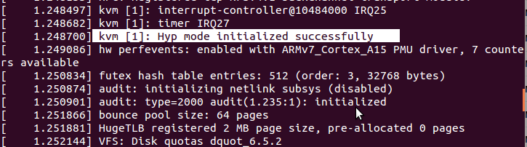
Booting up Host OS

Slide 34
Open vSwitch Support Modules
The installation of openvswitch daemon depends upon the modules : stp.ko, llc.ko, bridge.ko and vxlan.ko, so before conguring Open vSwitch make sure these modules
have been installed properly.
The version for Open vSwitch used for
build is openvswitch-2.3.10 as it is compatible with Linux kernel 3.14.32 so we need to make sure that sources for kernel 3.14.32 are present.

Slide 35
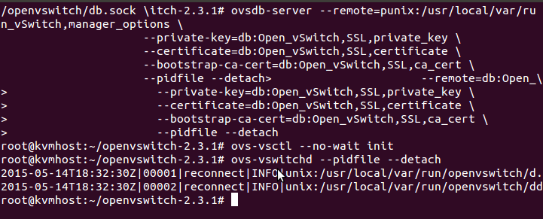
Open vSwitch Initialization

Slide 36
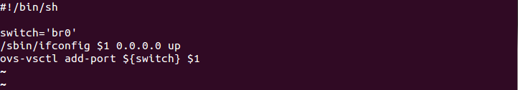
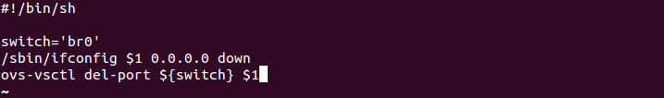
Qemu Scripts to boot Guest OS
Now we need to create custom versions of qemu-ifup and qemu-ifdown scripts that would be used in KVM conguration of guest OS.

Slide 37
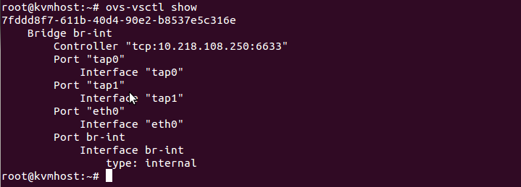
Adding tap interface to create network
Add the tap interface and the ethernet port to the bridge ‘br0’.

Slide 38
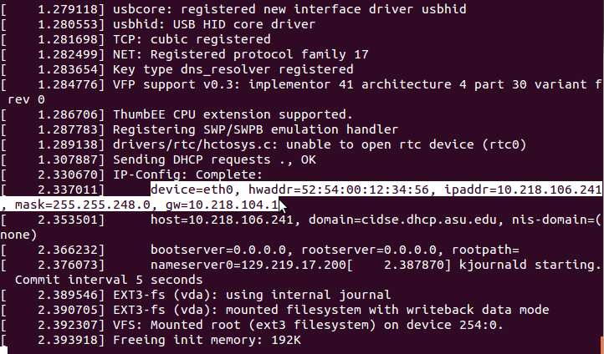
Boot the Guest OS using Qemu

Slide 39
Scope for Future

Slide 40
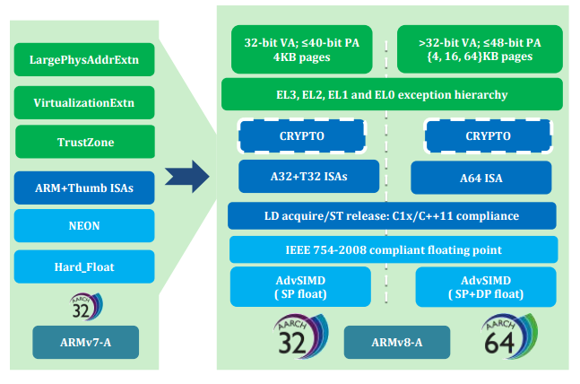
Porting to ARM v8

Slide 41
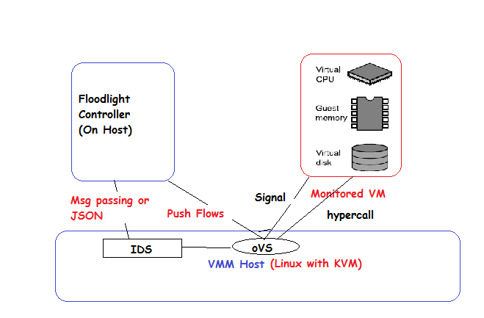
VMI based IDS
Network based IDS offers poor visibility- they cannot monitor internal state of host or events, all information has to be gleaned from network traffic to and from host.
VMI IDS directly observes hardware state and events and uses this information to extrapolate software state of host. This offers visibility comparable to HIDS.
Isolated from host – high degree of attack resistance even if host is corrupted.

Slide 42
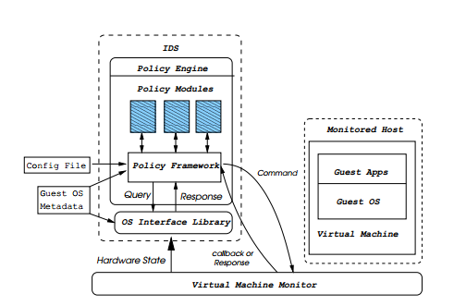
VMI Extensions to ARM
OS interface library will provide OS level view by interpreting hardware state exported by VM.
The policy engine consists of common framework for building policies.
Policy modules will implement specific intrusion detection policies.

Slide 43
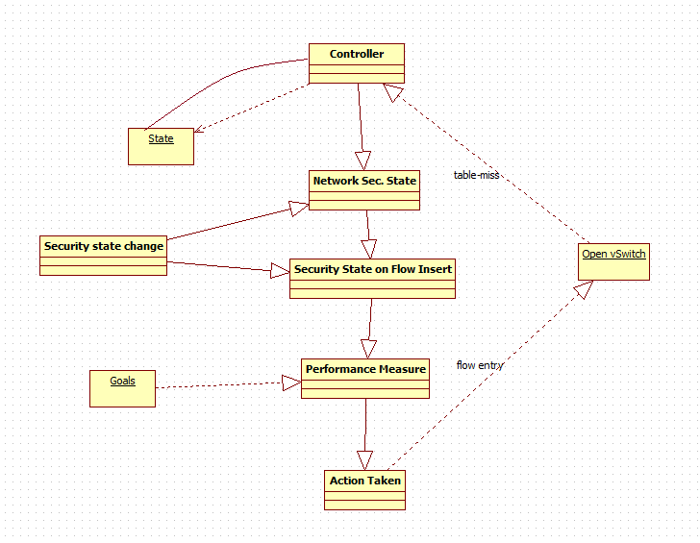
JARVIS: AI in SDN Security
Precept: New flow from the Open vSwitch.
Actions: Insert Flow (E.g.- Block/Redirect).
Goals: Remove any malicious software, fault tolerance.
Environment: Current Vulnerabilities, e.g- Nessus, NVD database.

Slide 44
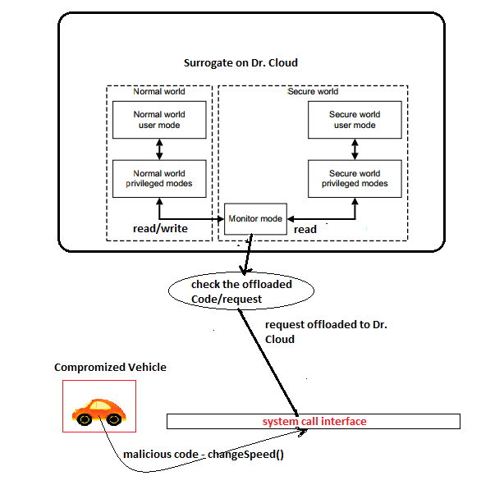
Surrogate as a Service
The core mode called monitor mode will allow context switch between two virtual processors running in time sliced fashion depending upon the offloaded code from Vehicle. Once the request reaches the monitor mode on surrogate, trusted software would route the request accordingly.
If operation requires access to secure world resources monitor mode would switch to Secure world, and remote user/adversary will have lower read privileges only.

Slide 45
References
Dall, C. and J. Nieh, \Kvm/arm: Experiences building the linux arm hypervisor", Tech. rep., Department of Computer Science, Columbia University, URL http://academiccommons.columbia.edu/catalog/ac%3A162668 (2013a)
Dall, C. and J. Nieh, \Supporting kvm on the arm architecture", LWN (2013b).
Foundation, L., \Xen arm with virtualization extensions whitepaper", Tech.
rep., XEN, URL http://wiki.xenproject.org/wiki/Xen_ARM_with_Virtualization_Extensions_whitepaper (2013).
Foundation, L., \Xen arm with virtualization extensions whitepaper", Tech. rep., XEN, URL http://wiki.xenproject.org/wiki/Xen_ARM_with_Virtualization_Extensions_whitepaper (2013).
Inc., A., \Porting to arm 64-bit", URL http://community.arm.com/docs/DOC-8453
(2014c).
LibVMI, \Virtual machine introspection", URL http://www.libvmi.com/ (2013).
Makita, T., \Virtual switching technologies and linux bridge", Tech. rep., NTT Open
Source Software Center, URL http://events.linuxfoundation.org/sites/events/files/slides/LinuxConJapan2014_makita_0.pdf (2014).
Lim, Z. S., \Setting up kvm", URL https://wiki.linaro.org/ZiShenLim/sandbox/SettingUpKVM (2013).

Slide 46
Peng, W., F. Li, X. Han, Keesook J.and Zou and J. Wu, \T-dominance: Prioritized
defense deployment for byod security", in \Communications and Network Security
(CNS) Conference", (IEEE, 2013).
SpA, M., \New security perspectives around byod", in \Broadband, Wireless Computing, Communication and Applications (BWCCA", (IEEE, 2012).
Systems, V. O., \svirt security for kvm virtualization on omap5 uevm", URL http//www.virtualopensystems.com/en/solutions/guides/kvm-svirt-omap5/
(2013)
Wu, H., D. Huang, Y. Xin, A. Chowdhary and Z. Wang, \Drive-in-the-cloud(dr.cloud): Surrogate service for autonomous vehicles", in \In proceedings
USENIX Hot Cloud", (USENIX, 2015).
Zhauniarovich, Y., G. Russello, M. Conti, B. Crispo and E. Fernandes, \Moses: Supporting and enforcing security proles on smartphones", in \Dependable and Secure
Computing, IEEE Transactions", (IEEE, 2014).
Technology, M., \Bring your own device", URL https://mti.com/Portals/0/Documents/White%20Paper/MTI_BYOD_WP_UK.pdf (2012).
Tootoonchian, A. and Y. Ganjali, \Hyperow: A distributed control plane for openflow", in \INM/WREN'10 Proceedings of the 2010 internet network managementconference on Research on enterprise networking", (IEEE, 2010).
LENGYEL, T. K., T. KITTEL, J. PFOH and C. ECKERT, \Multi-tiered security architecture for arm via the virtualization and security extensions.", in \25th International Workshop onDatabase and Expert Systems Applications", (IEEE, 2014).

Slide 47

THANK YOU

